Slide 1

ATLAS
Alexander Pela & Tristan Knott

Slide 2

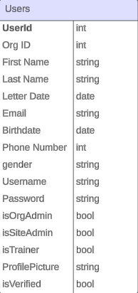
What is ATLAS?
“
”
A web-based Learning Management Software crafted to meet the training program needs of small-to medium-sized organizations.

Slide 3
Run Code
Examples
Show Organization Join and Create:
Personalize Account Settings/Enter Trainings on training manager. (ATLAS_JKerry1963, TestTrainer2!)
Site Manager show managing an organization (Alexander, AlexanderPela)

Slide 4
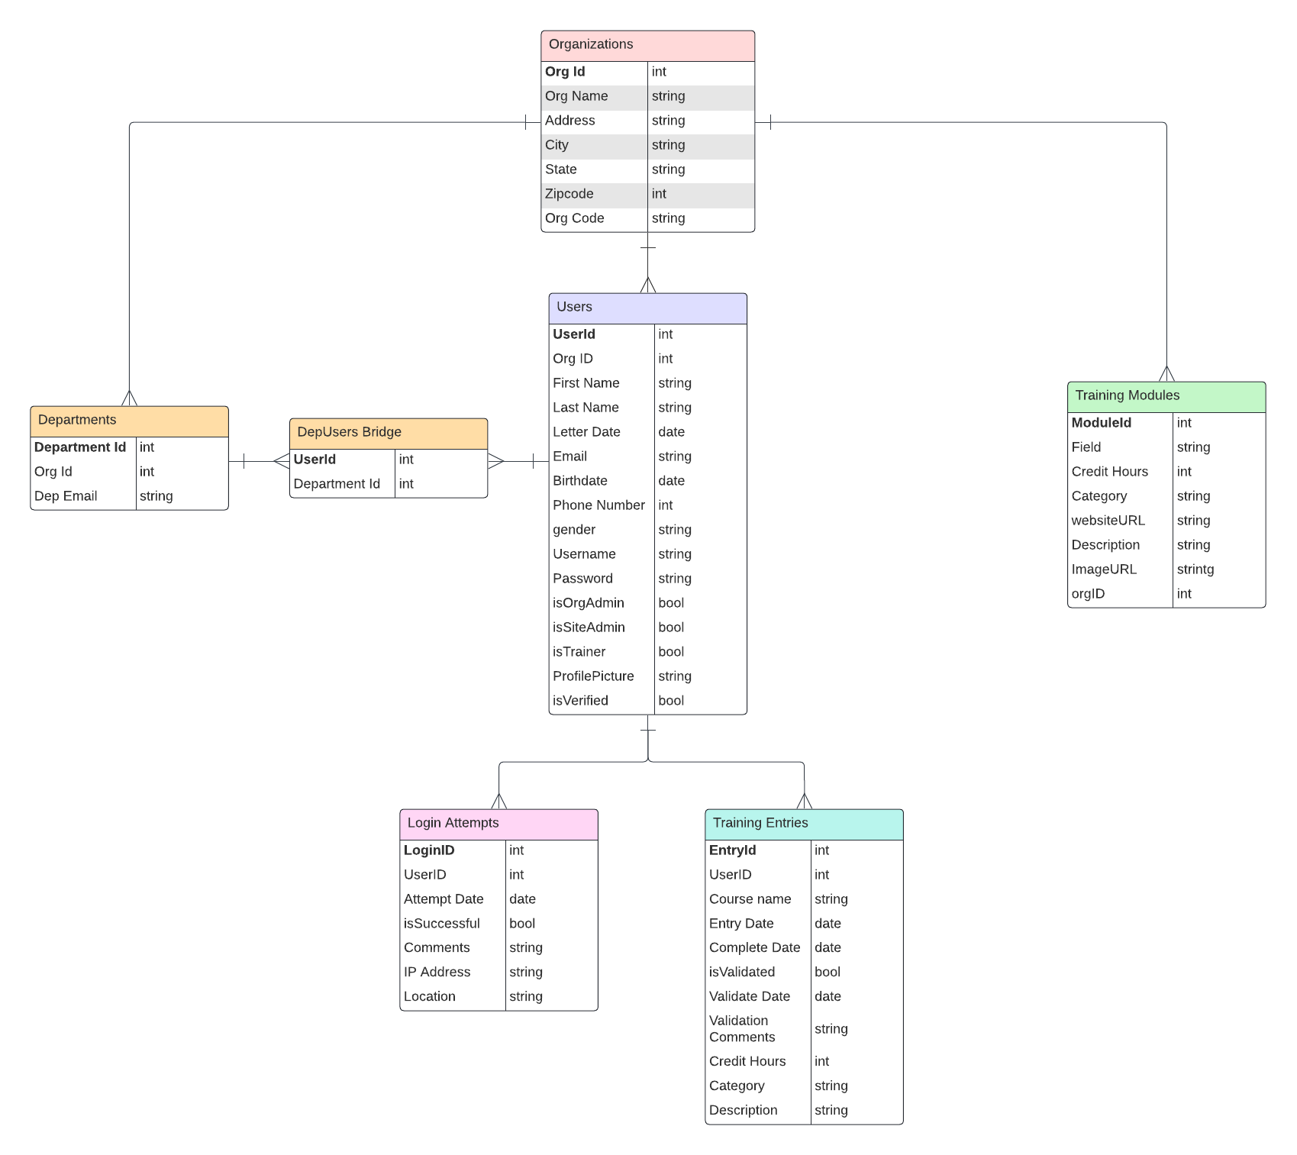
ERD

Slide 5
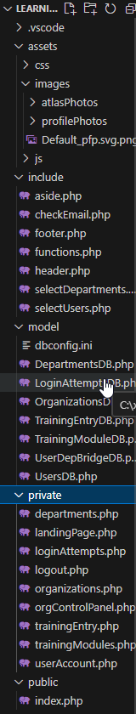
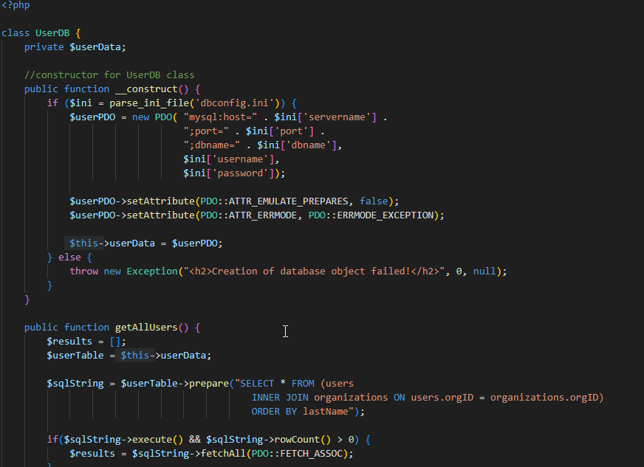
File Structure (UserDB)

Slide 6
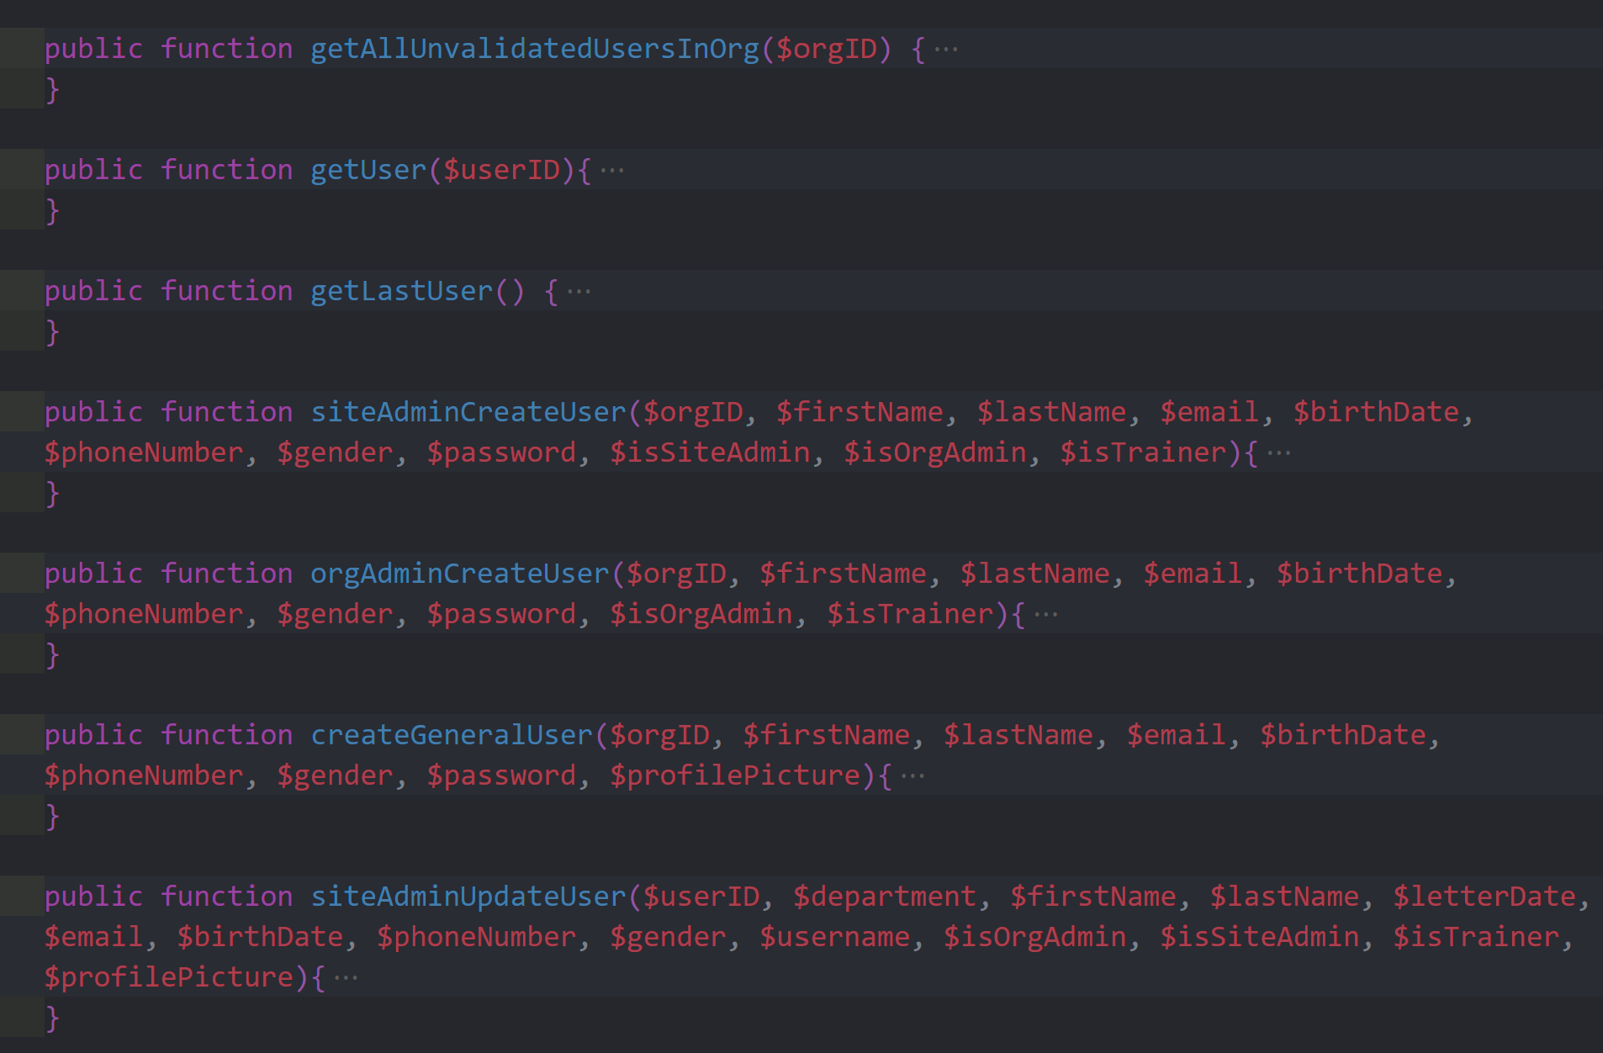
File Structure (UserDB)

Slide 7
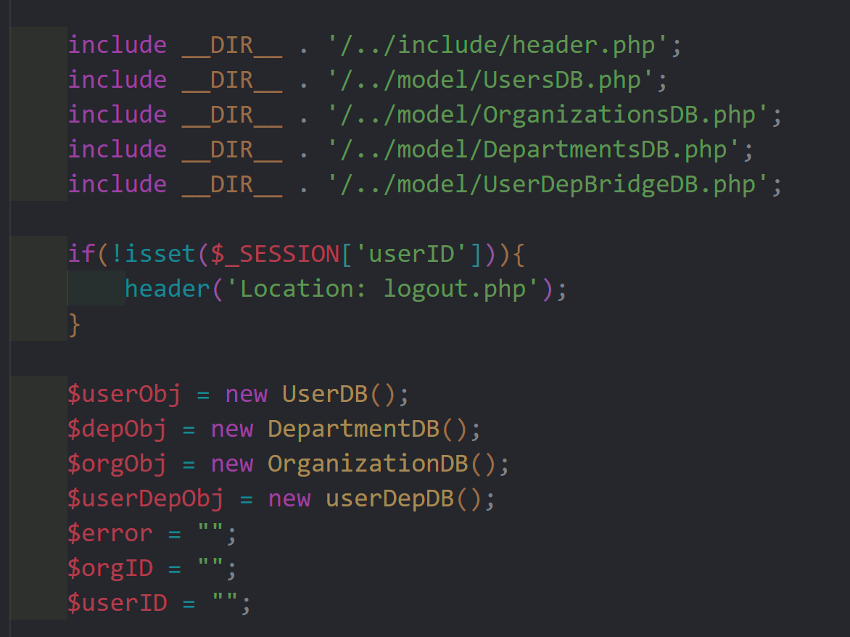
File Structure (UserDB)

Slide 8
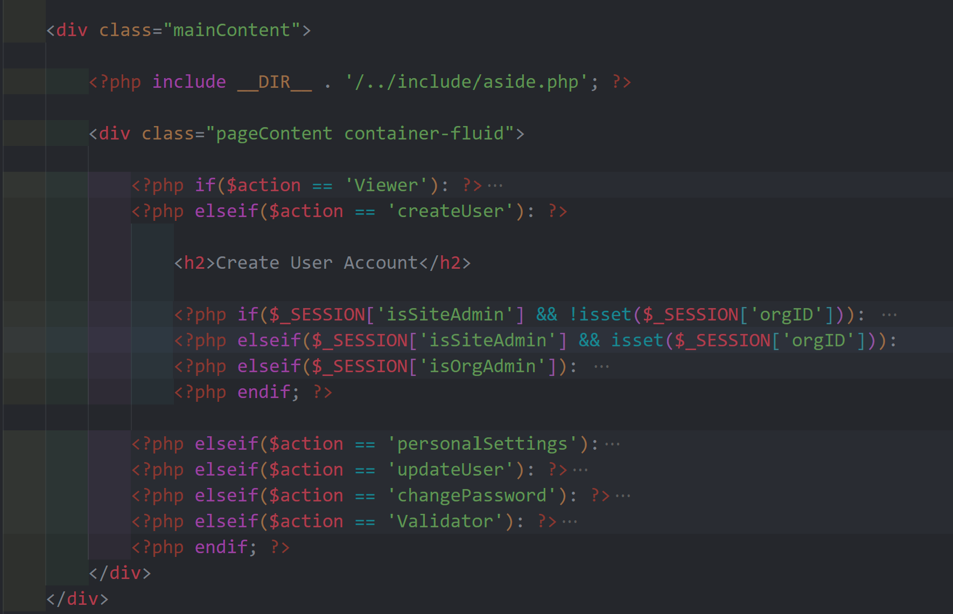
Action

Slide 9
Alex’s Successes, Failures, Impediments
Successes:
Understanding the “flow of code” (Pseudo coding with comments).
Creation of full-stack software.
Failures:
Job Codes feature was cut. (Too many levels of users and views).
Impediments:
Maintaining a healthy balance between project, other classes, work, etc.

Slide 10
Tristan’s Successes, Failures, Impediments
Successes:
Organizing code structures to better implement user status page variations
Utilizing bootstrap/css to quickly style and build site user interfaces
Failures:
Multiple departments per user was cut (ran out of time)
Impediments:
Efficiently managing time which extra classes, school, work, and personal life

Slide 11
What would you do differently
Design and Documentation time
Prioritize getting functionality coded first and then working on visual code
Figuring out how to better utilize each user’s landing page

Slide 12
Future Growth
Project:
Make trainings be assigned by departments in an organization.
Make Power BI like dashboards for users.
Reintroduce Job Codes.
Personal:
Work on website projects for other people to improve as Software Engineers.

